Slide 1

Youva Sikhar Manch (YSM)
A project as part of the Smart India Hackathon
Team: Codiestas
College Code: U-0497

Slide 2

Problem Statement
National Web Portal is used for designing Job oriented courses with the help of Human Resource data and desirable skill sets from industries.
Organization: Government of Uttarakhand

Slide 3
Idea Description
What we’re going to implement

Slide 4
Job Portal, that tailor the recommendations for the students.
Tailored suitable jobs and industry demanded courses.
Hassle free job description upload by industries.

Slide 5
Use Cases
Intended audience and users

Slide 6
Use Case | Actor
New Job Posting | Employer
Edit Job Posting | Employer
Conduct Assessments | Employer
View Recommended Jobs | Job-seeker / student
View Recommended Courses | Job-seeker / student
Apply to a job | Job-seeker / student

Slide 7
Tech Stack
Dependencies and technologies

Slide 8
Technology | Use
HTML, CSS, Javascript | Web development
JSP, Servlet, Hibernate, Spring | Business Layer
MySQL, MongoDB | Database
Python, Plotly.js, NLP | Pre-processing Job Description Data Analytics

Slide 9
Working
🏃
This is how we’ll implement

Slide 10
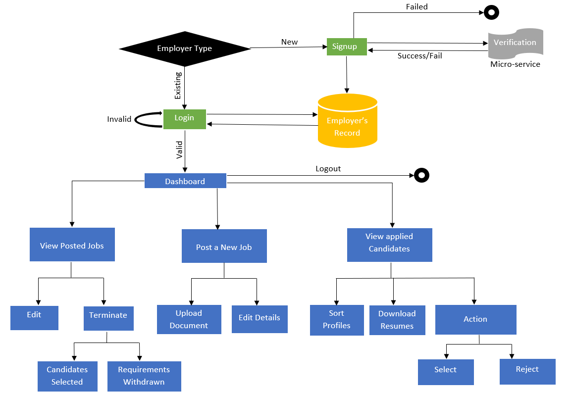
Employer’s Perspective

Slide 11
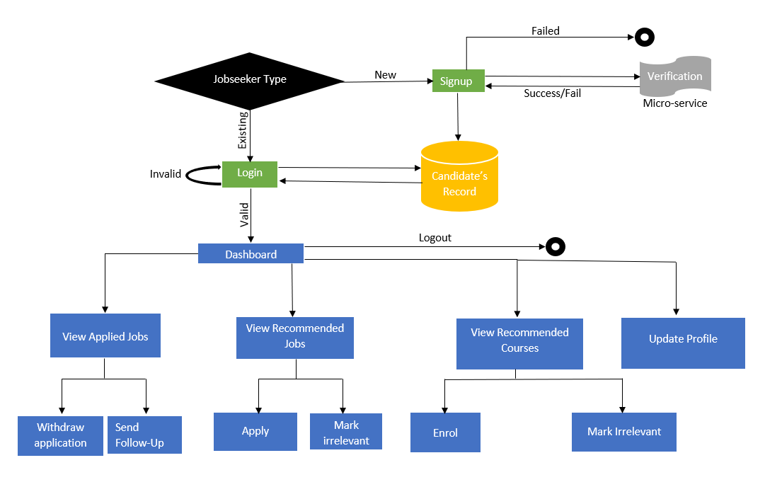
Job Seeker’s Perspective

Slide 12
Uniqueness
What so unique about our implementation

Slide 13
Zero Fake Jobs Assurance
Identity Verification of both Employer and Candidate
Tailored courses are not promotional
Curated goal-oriented jobs and courses for job seekers

Slide 14
UI Design
This is how our implementation would look

Slide 15
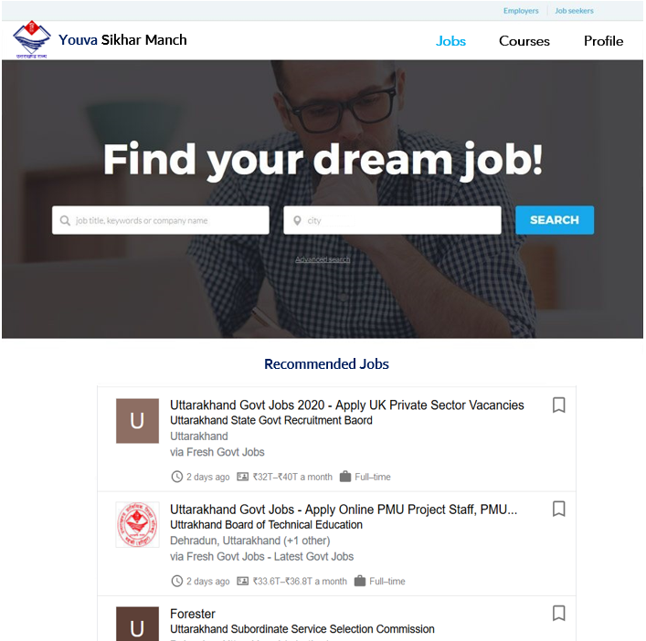
Job Seeker Portal

Slide 16

THANKS!
Presented by:
Yashi Srivastava
Ashutosh Agrahari
Baibhab Narayan Pal
Anchal Agarwal
Mohd Arbaaz
Apurva

